Slide 1

SOA PROJECT REVIEW – 1
AI-Enhanced Expense Tracking System
A Spring Boot microservices platform that helps users record, categorize and understand their expenses — with AI-assisted suggestions and insights.
TEAM MEMBERS
UNDER THE GUIDANCE OF
2420030634 Srivathsava Reddy
2420030140 R Sai Charan
2420030522 Y. Gowtham Reddy
2420030532 G. Devaki Nandan Varma
2420030559 M. Arjun Reddy
Neelima Gogineni
Professor, Dept. of CSE
KLH CSE, Bowrampet Campus
September 2026

Slide 2








Outline of Project Work
Eight sections covering the case for the project through to delivery plan
01
05
Introduction
Problem Gap Identification
02
06
Problem Statement
Innovation, Creativity & Novelty
03
07
Objectives
Project Architecture / Overview
04
08
Literature Survey
Feasibility & Project Plan
AI-Enhanced Expense Tracking System — SOA Review 1
2

Slide 3




Problem Statement
Manual expense tracking is slow, error-prone, and gives people little insight into where their money actually goes.
Time-consuming to manage
Records get lost or forgotten
Little automation today
Our proposed fix
Recording daily expenses manually takes real time and effort from users.
Users often forget to log expenses or lose track of where records are kept.
Existing tools mostly store and display expenses, with limited automation or personalization.
A simple system to record, view, and budget expenses — with AI to suggest categories and surface basic insights.
AI-Enhanced Expense Tracking System — SOA Review 1
3

Slide 4




Objectives
What the system is designed to deliver for the end user
Record, update & delete
Simple categorization
Spending visibility
Full control to record, update, and delete daily expenses.
Organize expenses into clear, simple categories.
View monthly and category-wise spending at a glance.
5
Budget monitoring
AI-assisted insights
core objectives guiding scope, design, and the Review-1 demo
Set and monitor a monthly budget in real time.
Use AI to suggest expense categories and surface simple spending insights.
AI-Enhanced Expense Tracking System — SOA Review 1
4

Slide 5
Literature Survey
Authors
Title / Area
Methodology
Inference
Limitation / Future Work
S. B. Patel et al.
Personal Expense Management System
Expense recording & category-based analysis
Helps users track and understand spending.
Limited automation and intelligent suggestions.
M. Kumar et al.
AI-Based Expense Categorization
Machine learning for text-based categories
Can reduce manual expense categorization.
Needs more training data for better accuracy.
Our Project
AI-Enhanced Expense Tracking System
Microservices + AI categorization
Simple tracking with basic AI insights.
Can be extended with better prediction and recommendations.
AI-Enhanced Expense Tracking System — SOA Review 1
5

Slide 6
Problem Gap Identification
CURRENT LIMITATION
OUR RESPONSE
Manual categorization is slow and error-prone
→
AI-powered automatic categorization
Basic tracking only stores and displays expenses
→
AI-based spending analysis
No personalized suggestions for the user
→
Personalized suggestions based on history
Manual entry requires significant user effort
→
Simple, user-friendly expense entry
Limited analysis makes patterns hard to see
→
AI-based spending insights
Traditional reports lack meaningful insight
→
Interactive reports and dashboards
Gap statement: Current systems mainly store and display expenses; this project adds AI categorization, personalized suggestions, and simple spending insights.
AI-Enhanced Expense Tracking System — SOA Review 1
6

Slide 7



Innovation, Creativity & Novelty
Simple & user-friendly
A straightforward expense tracking experience with minimal friction.
AI category suggestions
AI suggests categories directly from expense descriptions.
History-aware insights
Basic spending insights generated from the user's own history.
Budget monitoring
Monthly budget monitoring keeps spending on track.
Microservices design
A microservices-based architecture built for easy maintenance.
AI-Enhanced Expense Tracking System — SOA Review 1
7

Slide 8
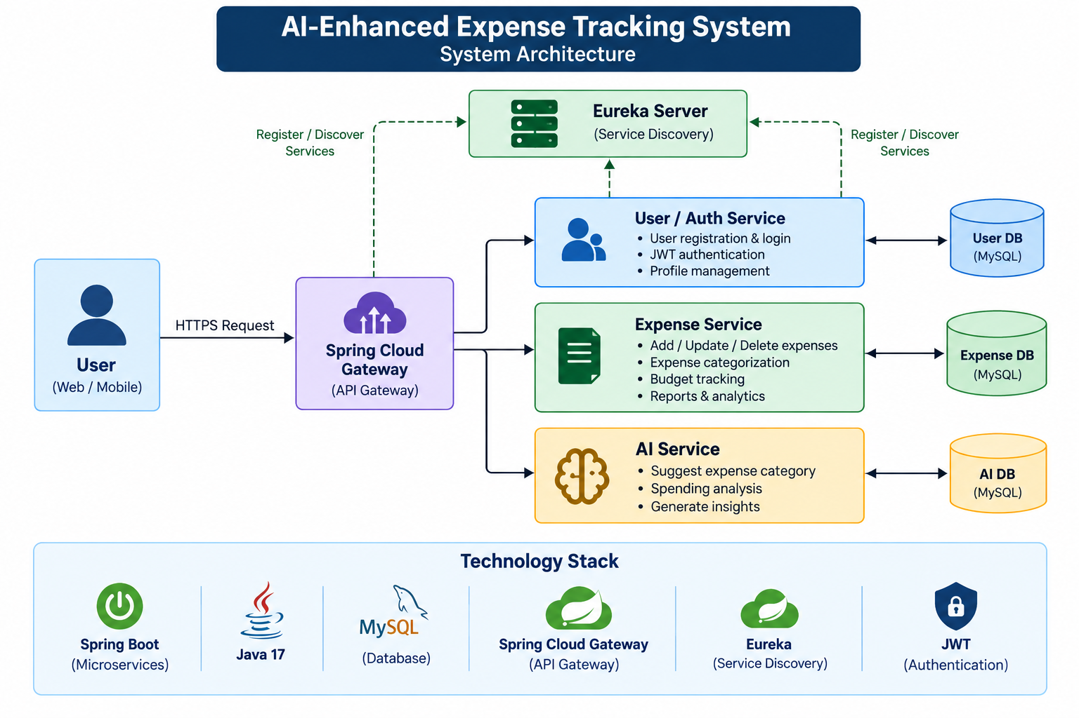
Project Architecture / Overview

Slide 9





Feasibility & Project Plan
The project is feasible using Spring Boot, MySQL, REST APIs, JWT, Eureka and Spring Cloud Gateway. AI is kept simple: expense-description categorization and basic spending analysis.
SIX-WEEK DELIVERY PLAN
Week 1
Week 2
Week 3
Week 4
Week 5
Week 6
Requirements & design
User & authentication service
Expense service & database
AI feature & reports
Testing & security
Integration, CI/CD & final demo
TOOLS & TECHNOLOGIES
Spring Boot
MySQL
REST APIs
JWT
Eureka
Spring Cloud Gateway
Postman
GitHub Actions
Semgrep
Jira
Lucidchart AI
AI-Enhanced Expense Tracking System — SOA Review 1
9

